Slide 1
Divine Human Mediators across religions
By Group 2: Makayla Mendoza, Shreya Jeedigunta, Kenedy Anderson, Estevan Gonzalez, Johnathan Faucett, Jacelyn Tolosa

Slide 2
Defining Divine-Human Mediators
Mediator: a person who attempts to make people involved in a conflict come to an agreement; a go-between.(Synonyms include middle-man, negotiator, etc.)
In religion: A divine human mediator has the role of connecting humanity and God(s), some known divine human mediators include Jesus Christ (Christianity), Hujja/Imams (Islam), Messaish Yeshua (Judaism)
Why do we need a mediator? A mediator is able to bring followers to eternal salvation due to taking all of humanity’s sins and purifying them, therefore allowing all the followers to embrace God(s)

Slide 3

Divine-Human Mediators in Christianity: The Clergy
Priest: defined as “elder” in Greek. They are in more connection with the Eucharist, meaning his duties also include listening to confessions and granting ways of forgiveness. He is seen as the head person to go to as the seeing God to the people.
Deacon: means “helper” in Greek. Helps in the practical and charitable functions of the church. These men carry out things like Baptisms, giving out the Eucharist, preaching, blessing marriages, and officiating funerals. Women Deacons are mostly known in Protestant denominations, and they were charged in rather than ordained.
Bishop: Have the right to ordain other members of the clergy, and their main duty is to supervise. Have different levels that include a Pope, cardinals, archbishop, patriarchs, and metropolitans. They are believed to be the successors of the Apostles.
Pope: head of the Roman Catholic Church. He is seen as the successor of St. Peter who was the head of the Apostles. He is meant to have the most power over all the Churches in cases of morals and faith
Notes:
E. (Ed.). (2020, February). Pope. Retrieved November 10, 2020, from https://www.britannica.com/topic/pope
T. (Ed.). (2018, October 18). Bishop. Retrieved November 10, 2020, from https://www.britannica.com/topic/bishop-Christianity
T. (Ed.). (2013, April 23). Deacon. Retrieved November 10, 2020, from https://www.britannica.com/topic/deacon
The, E. (2020, May 18). Priest. Retrieved November 10, 2020, from https://www.britannica.com/topic/priest-Christianity

Slide 4
Divine-Human Mediators in Christianity:
Prophets: people who have proclaimed a message given to them by God. God speaks to the people through them. They are meant to show people the true meaning of God rather than the version they are seeing at the time. Some prophets are: Moses and Abraham.
Saints: people who have complete holiness in their lives. The Holy Spirit lives through them. Believed to be sent directly into heaven and has a seat directly under God himself. Meant to be looked up to in terms of livin up to Holy expectations.
Jesus Christ (the messiah): Messiah meaning “the anointed one.” Religious leader of Christianity, and regarded as reincarnation of God born from The Virgin Mary. Taught about the Kingdom of God. Believed to have died through Crucifiction and then rose from the dead three days later. Is part of the Eucharist as the “son of God.”
Notes:
Prophet Definition and Meaning - Bible Dictionary. (n.d.). Retrieved November 10, 2020, from https://www.biblestudytools.com/dictionary/prophet/
Stephon, M. (2020, September 10). Art and iconography. Retrieved November 10, 2020, from https://www.britannica.com/topic/Christianity/Art-and-iconography
Pelikan, J. J., & Sanders, E. (2019, September 13). The picture of Christ in the early church: The Apostles' Creed. Retrieved November 10, 2020, from https://www.britannica.com/biography/Jesus/The-picture-of-Christ-in-the-early-church-The-Apostles-Creed

Slide 5
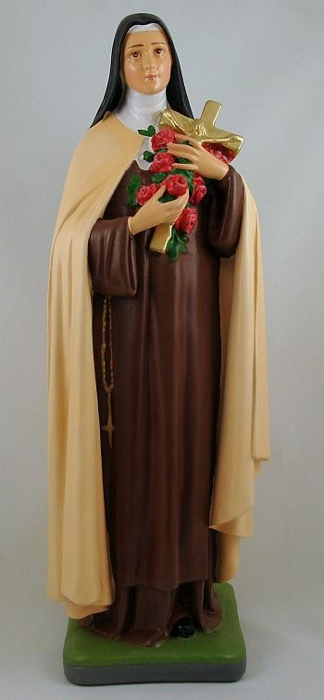
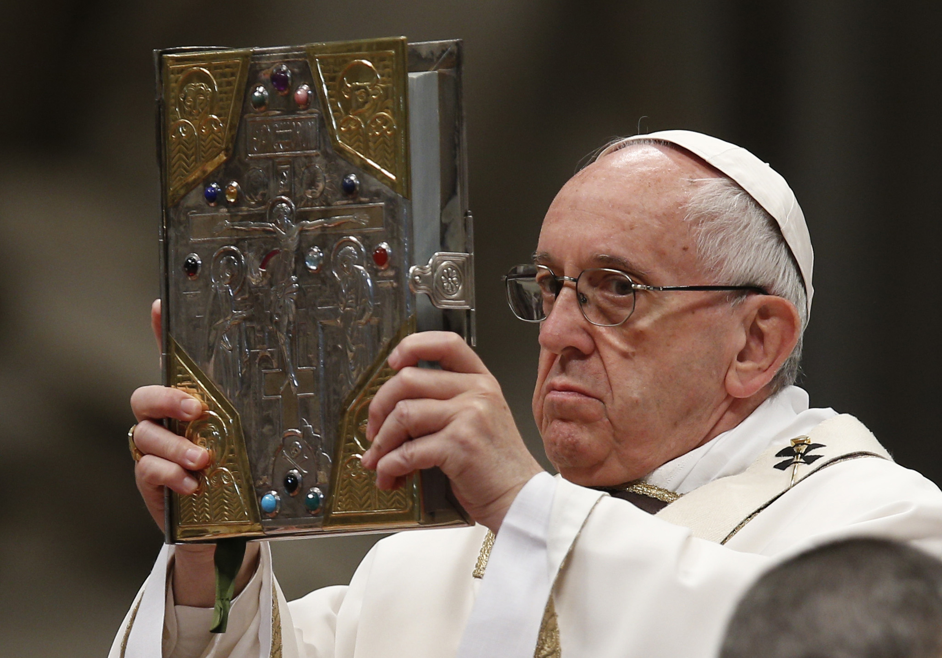
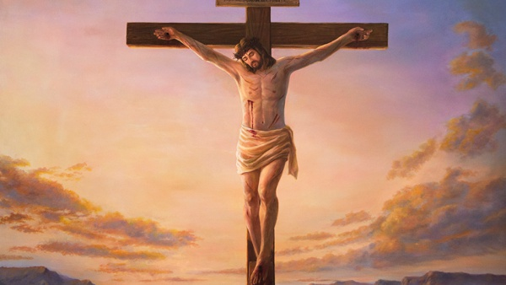
Curent Pope- Pope Francis:
Statue of Saint Theresa:
Jesus Christ on the Cross:

Slide 6
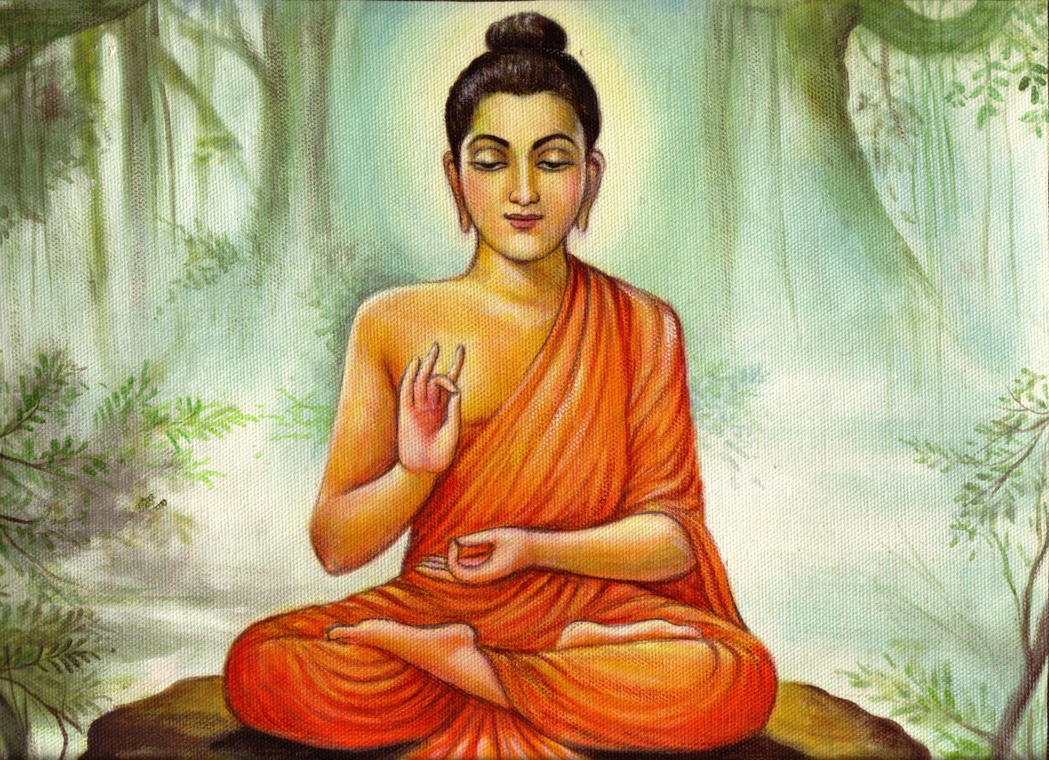
Buddhism
Buddhism is about being enlightened
You become enlightened by meditating and reflecting
By achieving enlightenment you realize your true self
Audio https://youtu.be/nYS-eH3rdOo

Slide 7
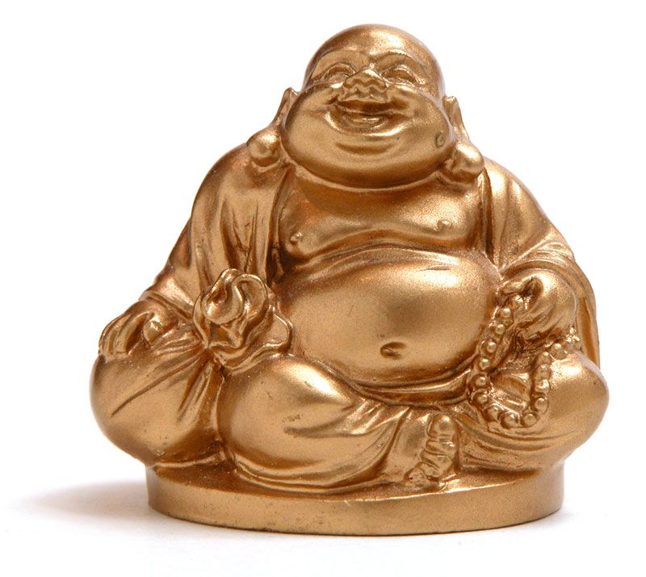
Buddhism
The divine mediator is Buddha
The only human to be fully is Buddha
Became self aware and truly enlightened
Audio https://youtu.be/nYS-eH3rdOo

Slide 8
Hinduism
Angiras is a vedic sage (rishi) who is described as the educator/ teacher for divine knowledge who could be considered as a bridge between the message of humanity and Gods
In Hinduism, many of the gods branched out from other gods and created a web of deities who took shape and ranged from normal humans to supernatural beings. Many of these gods which were considered to be in a human form could also be taken as a divine mediator. (Ex: Sai Baba)
In Vedic mediation, the teachings relied on one human and one divine mediator but unlike other (usually Abrahamic) religions, Hinduism does not have one mediator who guides the people, followers worship many different Gods based on circumstances and there could be divine mediators for each God
Humans who have interacted with God in their human form can also be considered as a form of mediator such as all those who interacted with Lord Krishna or Rama in their forms during the Mahabharatha
Priests are nowadays considered to be the main divine mediators because they take part in keeping up with statues of God. For example, in Tirupati and Shirdi, two very popular religious destinations, it is said that the place where the statue/ shrine is located is the actual final resting spot of the Lord.
Notes:
audio

Slide 9
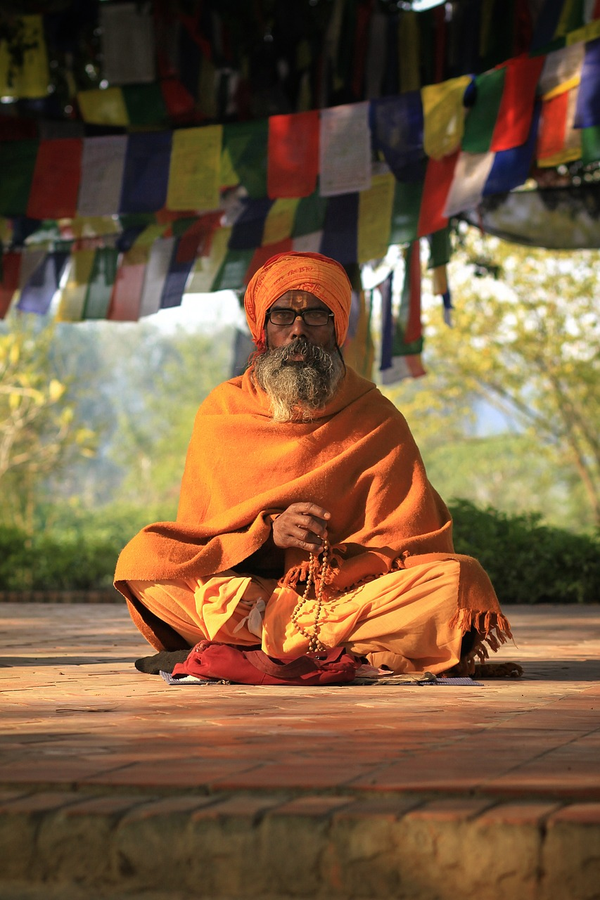
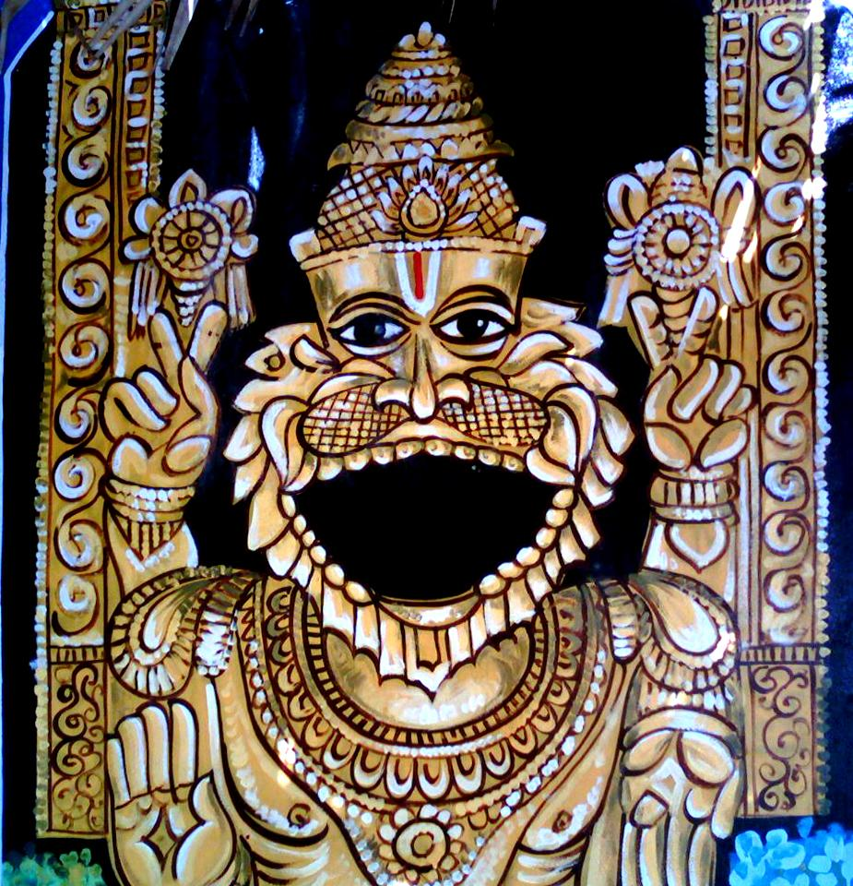
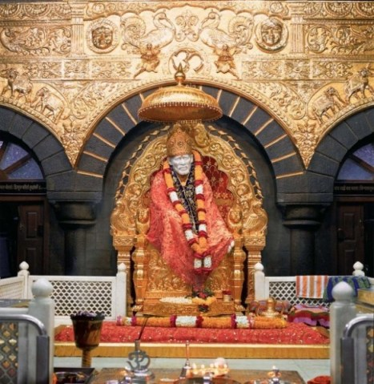
Hinduism
Popular stories are told saying that in Shirdi, one can hear the Baba say Om early in the mornings and since the Priest is the one who is able to hear that, all the head priests in the Temples are considered divine mediators
In a Temple in South India, there is a place where people can go and give a certain amount of a sugar syrup to the statue and no matter how much is given to the statue, half of the amount comes back out and one can hear the gulping noises made by the rock statue as half of the syrup is drank. The other half which comes out is used as the form of prasad. When looking at this example, one can say that basic humans are also such mediators because the interaction is between God and a human.

Slide 10
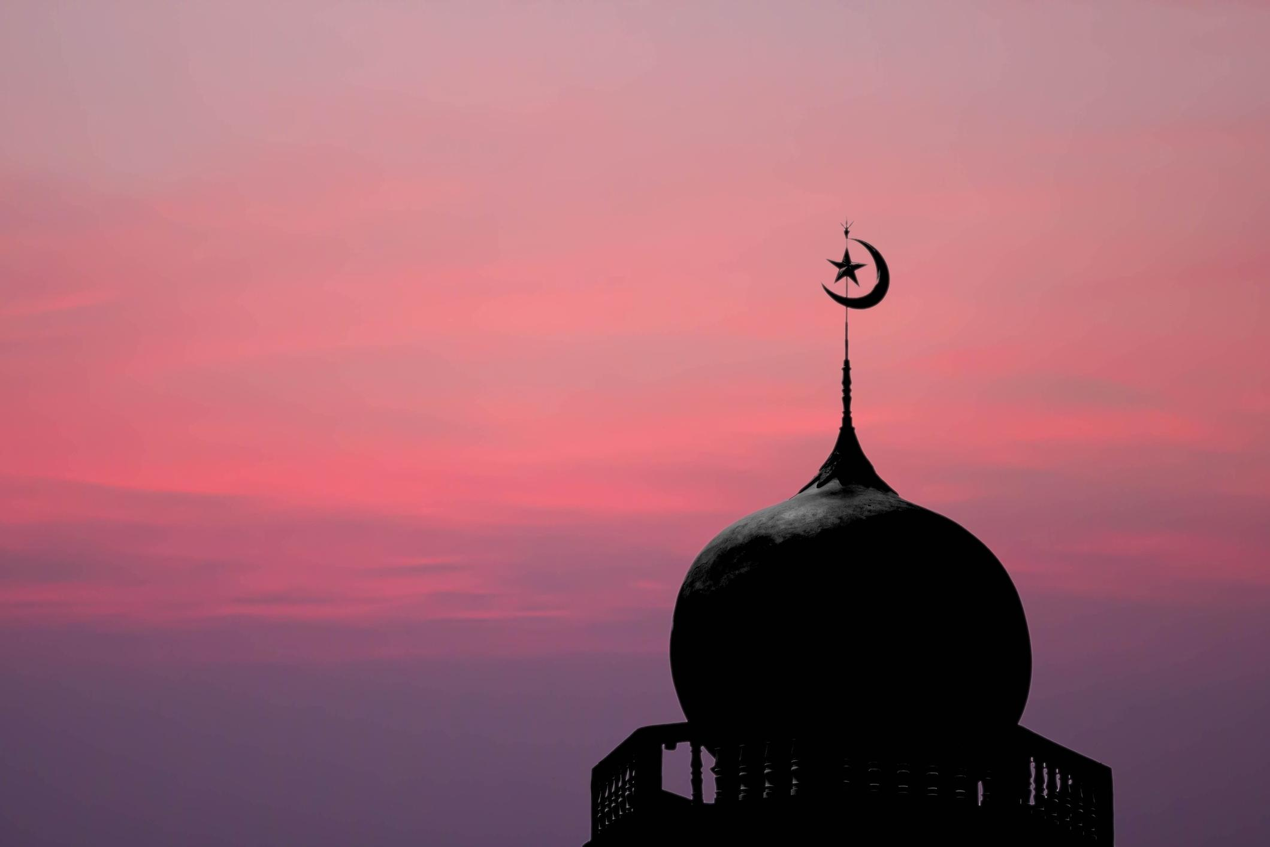
Divine-Human Mediators in
Islam
Mediation in Islam is very clearly spoken about in the Qur’an. This can be said to show the importance of settling disputes in Islam, and they like to do this in a peaceful and compromising manner.
Mediation is very important in Islamic law and is highly likely to occur in cases of litigation and arbitration. In Islamic law, a mediator is chosen based on respect and knowledge of the law. In addition to this, a mediator must always take relevant Islamic law into consideration, both that which is legally binding and that which is merely recommended.
It should also be considered that Muhammad was considered to be the last prophet in Islam that was sent by Allah, so there is currently no longer any divine and human mediators. Therefore, after Muhammad died no one else could directly talk to Allah, though some say that they talk to themselves in their head and picture that they are talking to Allah. It is widely agreed upon that there was 25 prophets in total, but Muhammad is considered to be the last one.
Followers of Islam also believe that there is no need for a mediator when the law is clear and certain, a mediator is only required when the law is unclear or uncertain. This is stated directly in the Islamic law.

Slide 11
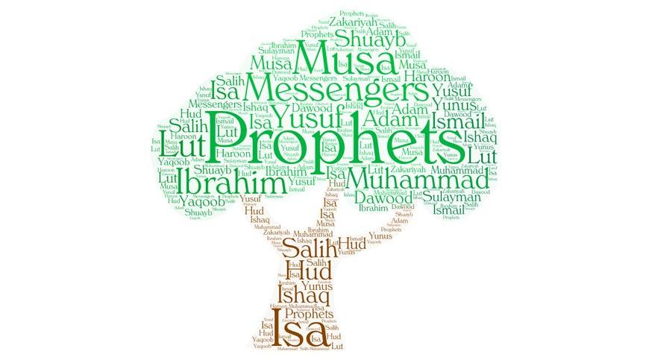
Previous prophets (Mediators) in Islam
Adam
Muslims believe that Adam was given knowledge to pass on to the rest of the human race.
Ibraham
Ibrahim is regarded in Islam as the father of the Arab people.
His faith was tested by Allah, which teaches Muslims that they must be prepared to submit to Allah in the same way.
Musa (Known as Moses in Abrahamic religions such as Christianity)
Musa is thought to have been the only prophet that Allah spoke to directly.
Isa
Isa is known as Jesus in Christianity. However, in contrast to Christians, Muslims do not believe that Isa was crucified and resurrected, or that he was the son of God.
Muhammad (Thought to be the last prophet that gave Muslims the Qur’an)
Muhammad is the final prophet in Islam, known as the ‘Seal of the Prophets’. This means that Muslims regard Muhammad as Allah’s final messenger. The Qur’an is formed from the revelations Muhammad received from God through the Angel Jibril. Muslims do not believe that Muhammad was in any way divine, and this is confirmed in the Qur’an, which states: Muhammad is no more than a messenger (Surah 3:144).

Slide 12
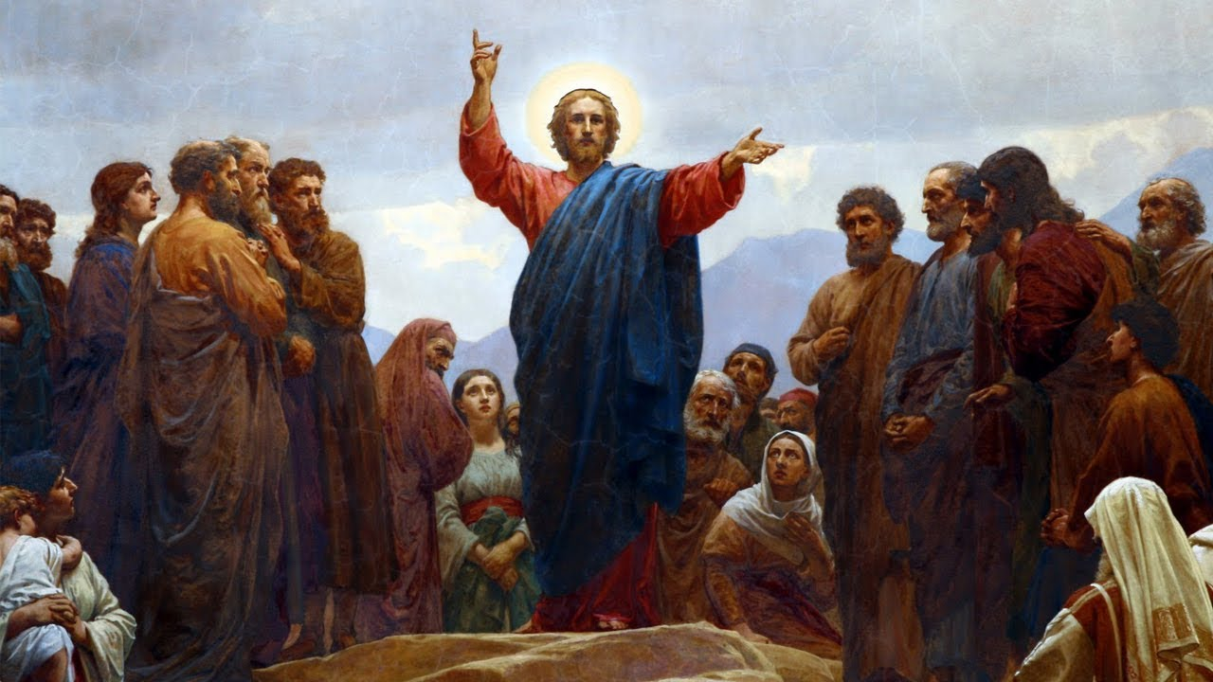
Judaism
Many teach that there is no mediator between a person and the true God
Early 1st century traditions taught the idea that humans didn’t need someone to stand in the way of them and God.
Some traditions substitute other mediators for Yeshua (Jesus)
Other traditions have a desire to protect Jesus’ status as a deity
There is one God, and one Mediator also between God and men: the man Messiah Yeshua. (1 Timothy 2:5)
Paul’s original statement in 1 Timothy that there is “one mediator” has two meanings. There is a God provided mediator, for which we should be thankful, and there is only one mediator, which disallows for others who crave or are given his position.
Ideology of Divine Human Mediators for Judaism:

Slide 13
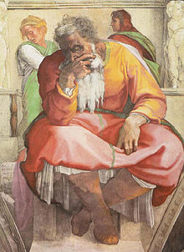
Judaism
Hebrew Prophet Human Mediators:
One key idea that began with Jewish traditions is the belief in deceased Saints that still serve as mediators.
Jeremiah was the prophet that people still believed had a great impact on their lives even centuries after his death
Samuel was a human mediator and prophet that people asked to pray for their well-being
Hebrew scripture teaches that God sends mediators, but this doesn’t change the fact that Judaism recognizes no intermediary between man and God.
Primary mediators were the prophets like Jeremiah, Moses, Abraham and Samuel and not priests like is commonly thought
Many Jews today believe rabbis are mediators between people and God even though it goes against Jewish doctrine.

Slide 14
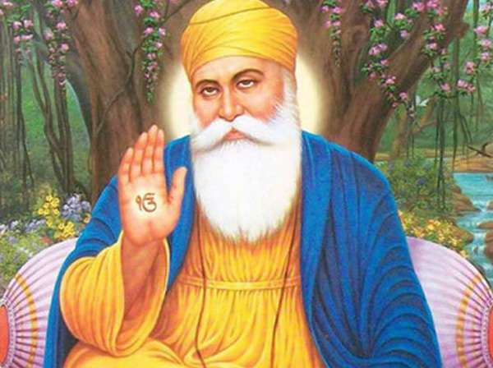
Sikhism
What do Sikhs believe about God?
There is only one God
God is without form, or gender
Everyone has direct access to God
Everyone is equal before God
Sikhs believe that God can't be understood properly by human beings, but he can be experienced through love, worship, and contemplation.
Sikhs look for God both inside themselves and in the world around them. They do this to help themselves achieve liberation and union with God.
Sikh spirituality is centred round the need to understand and experience God, and eventually become one with God.

Slide 15
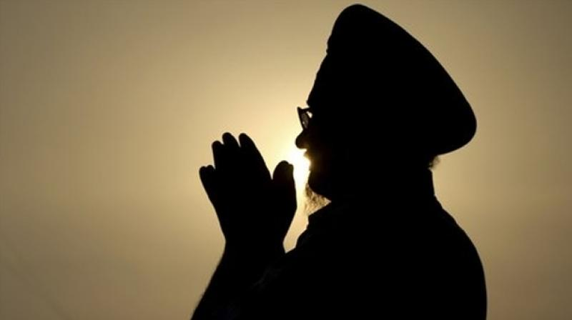
Human Mediators in Sikhism
Sikhs do not believe that you need a mediator to be able to connect with God. They believe that we live this life on earth to live a good life for God, in order to become one with God. “Sikhs don't think it pleases God if people pay no attention to others and simply devote themselves slavishly to religion. Sikhism doesn’t ask people to turn away from ordinary life to get closer to God. In fact it demands that they use ordinary life as a way to get closer to God. A Sikh serves God by serving (seva) other people every day. By devoting their lives to service they get rid of their own ego and pride.” Sikhs look for God inside themselves and in the world around them. They do this to help themselves achieve liberation and union with God.

Slide 16
Bibliography
Mody, R., Foord, M., Olliffe, M., Adam, P., Balogh, A., Orr, P., & Smith, C. (2018, September 01). The Divine Mediator: How Calvin's Debate with Francesco Stancaro can help us think about Functional Subordination in the Trinity. - The Gospel Coalition: Australia. Retrieved November 12, 2020, from https://au.thegospelcoalition.org/article/divine-mediator-calvins-debate-francesco-stancaro-can-help-us-think-functional-subordination-trinity/
E. (Ed.). (2020, February). Pope. Retrieved November 10, 2020, from https://www.britannica.com/topic/pope
T. (Ed.). (2018, October 18). Bishop. Retrieved November 10, 2020, from https://www.britannica.com/topic/bishop-Christianity
T. (Ed.). (2013, April 23). Deacon. Retrieved November 10, 2020, from https://www.britannica.com/topic/deacon
The, E. (2020, May 18). Priest. Retrieved November 10, 2020, from https://www.britannica.com/topic/priest-Christianity
Prophet Definition and Meaning - Bible Dictionary. (n.d.). Retrieved November 10, 2020, from https://www.biblestudytools.com/dictionary/prophet/
Stephon, M. (2020, September 10). Art and iconography. Retrieved November 10, 2020, from https://www.britannica.com/topic/Christianity/Art-and-iconography
Pelikan, J. J., & Sanders, E. (2019, September 13). The picture of Christ in the early church: The Apostles' Creed. Retrieved November 10, 2020, from https://www.britannica.com/biography/Jesus/The-picture-of-Christ-in-the-early-church-The-Apostles-Creed
https://www.britannica.com/topic/Hinduism/Theology

Slide 17
Bibliography Continued
Sayers, Matthew R. “Claiming Modes of Mediation in Ancient Hindu and Buddhist Ancestor Worship.” Journal of Ritual Studies, vol. 26, no. 1, 2012, pp. 5–18. JSTOR, www.jstor.org/stable/44368844. Accessed 11 Nov. 2020.
“Religions - Buddhism: The Buddha.” BBC, BBC, 2 Oct. 2002, www.bbc.co.uk/religion/religions/buddhism/history/history.shtml.
Azwina Wati Abdull Manaf. (2020 Jan. 6) “Mediators in Islam” https://www.researchgate.net/publication/326101733_Mediation_in_Islam
“Buddha.” Biography.com, A&E Networks Television, 13 July 2020, www.biography.com/religious-figure/buddha.
The prophets before Muhammad. (2020) https://www.bbc.co.uk/bitesize/guides/zr4r97h/revision/6
Sumner, Paul. “Mediators in the Tanakh and the Mediator Messiah.” Hebrew Streams: Mediators in the Tanakh, www.hebrew-streams.org/works/hebrew/mediator.html.
Religions - Sikhism: Sikh Beliefs. (2009, September 24). Retrieved November 12, 2020, from https://www.bbc.co.uk/religion/religions/sikhism/beliefs/beliefs.shtml

